Slide 1
EENG 284: Digital Logic
Verilog help for Lab1
Prachi Sharma

Slide 2
Lab 1: f02
Symbolic logic function to be implemented:
f02 = a’ + bc’
In Verilog
assign f02 = ~a | (b & ~c);

Slide 3
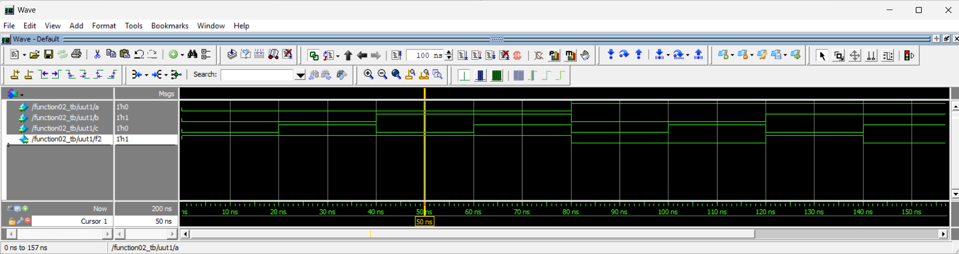
Lab 1: f02
Truth Table from Timing Diagram
Signal values
cursor
Notes:
You can choose the LSB which changes every bit and then say find next transition in the toolbar on the top

Slide 4
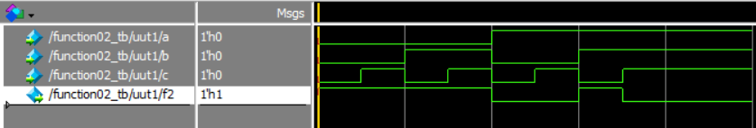
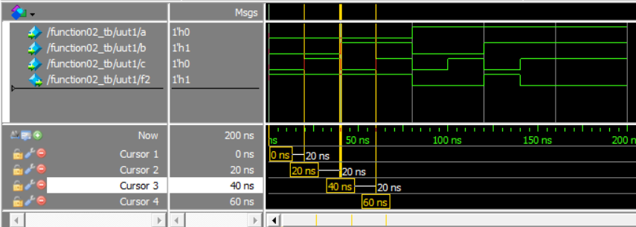
Lab 1: f02 (use the cursor!)
Truth Table from Timing Diagram
A | B | C | F
0 | 0 | 0
0 | 0 | 1
0 | 1 | 0
0 | 1 | 1
1 | 0 | 0
1 | 0 | 1
1 | 1 | 0
1 | 1 | 1

Slide 5
Lab 1: f02 (use the cursor!)
You can move the cursor on the timing diagram to find the o/p for each i/p combination in the truth table.
A very easy way to do this is find the bit that changes every row of your truth table (aka LSB, in this case ‘c’). Select the LSB and keep choosing ‘find next transition’ in the toolbar on the top to get all the rows of your truth table!
We can also add multiple cursors, one at every transition.
Try to explore this during the lab otherwise we will discuss it during class on Wednesday!

Slide 6
Lab 1: f03
Draw the circuit diagram for f03
assign p1 = ~a & ~b & c;
assign p2 = ~a & b & ~c;
assign p4 = a & ~b & ~c;
assign p7 = a & b & c;
assign f03 = p1 | p2 | p4 | p7;
Identify what i/p signals are required: we need a, b, c and their complements (NOT of a signal is called its complement).
Generate the intermediate signals p1, p2, p4, p7. Each needs a 3-i/p AND gate.
Generate f03: use a 4-i/p OR gate.

Slide 7
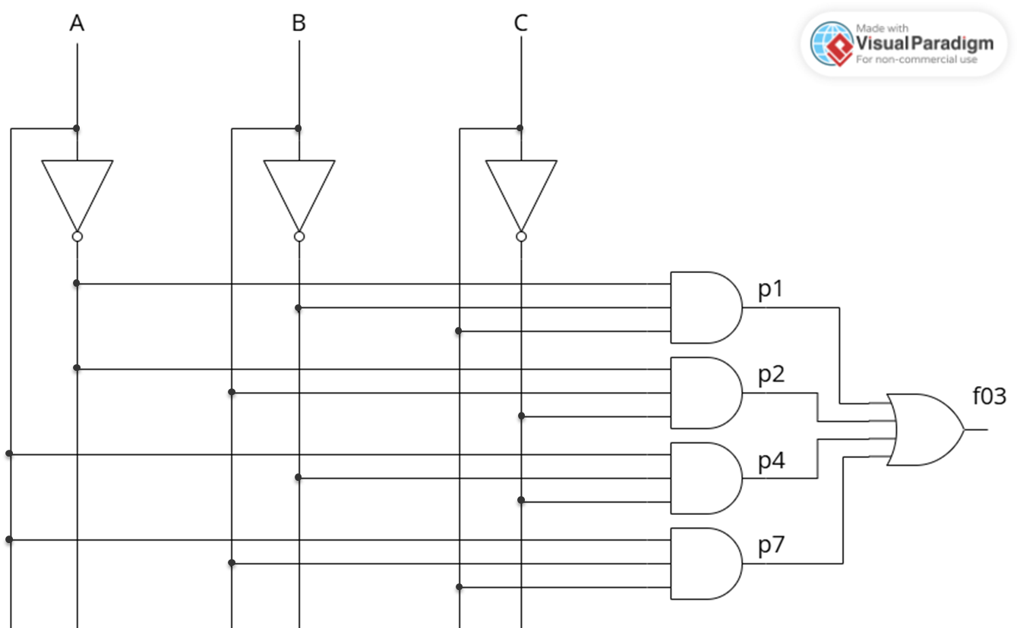
Lab 1: f03

Slide 8
Lab 1: f03
Write the symbolic form of f03
assign p1 = ~a & ~b & c;
assign p2 = ~a & b & ~c;
assign p4 = a & ~b & ~c;
assign p7 = a & b & c;
assign f03 = p1 | p2 | p4 | p7;
f03 = p1 + p2 + p4 + p7
p1 = a’b’c
p2 = a’bc’
p4 = ab’c’
p7 = abc
f03 = a’b’c + a’bc’ + ab’c’ + abc

Slide 9
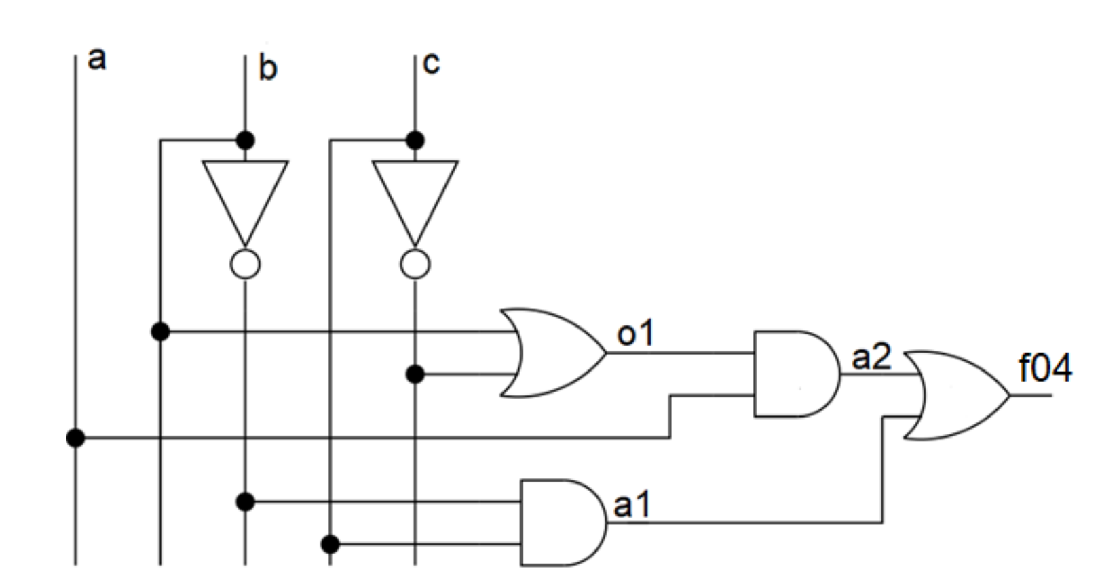
Lab 1: f04
assign o1 = b | ~c;
assign f04 = a1 | a2;
assign a2 = o1 & a;
assign a1 = ~b & c;

